Slide 1


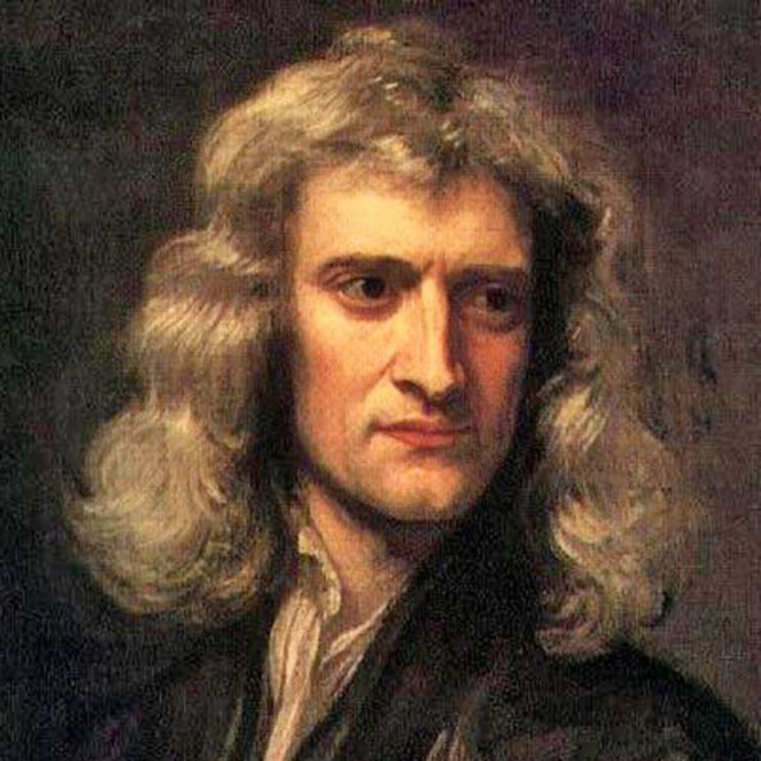
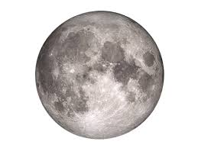
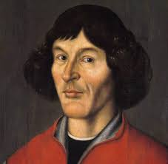
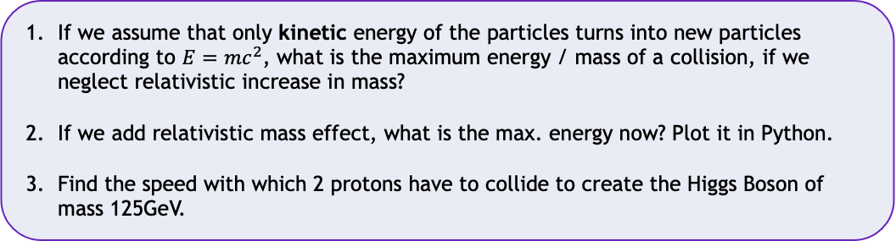
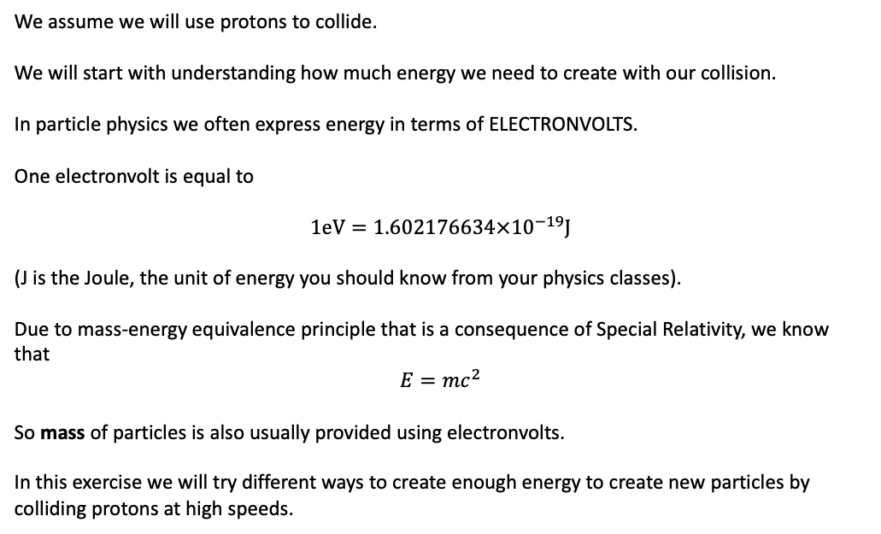
解密神奇的宇宙 Unlocking the secrets of the Universe
Project: Constructing Particle Accelerators
Cyclotrons
Today’s VIP guest list
We assume we will use protons to collide.
We will start with understanding how much energy we need to create with our collision.
In particle physics we often express energy in terms of ELECTRONVOLTS.
One electronvolt is equal to
$$1eV=1.602176634×{10}^{−19}J$$
(J is the Joule, the unit of energy you should know from your physics classes).
Due to mass-energy equivalence principle that is a consequence of Special Relativity, we know that
$$E=mc^{2}$$
So mass of particles is also usually provided using electronvolts.
In this exercise we will try different ways to create enough energy to create new particles by colliding protons at high speeds.
Isaac Newton
Task 1
If we assume that only kinetic energy of the particles turns into new particles according to $E=mc^{2}$, what is the maximum energy / mass of a collision, if we neglect relativistic increase in mass?
If we add relativistic mass effect, what is the max. energy now? Plot it in Python.
Find the speed with which 2 protons have to collide to create the Higgs Boson of mass 125GeV.

Slide 2

解密神奇的宇宙 Unlocking the Secrets of the Universe
Task 2
In Python, estimate the length that a linear collider would have to have to reach the speed you found in Task 1 necessary for producing the Higgs boson.
Tasks 3-4
Follow instructions in Python file to complete the project.
JinJin STEM Academy

